Slide 1
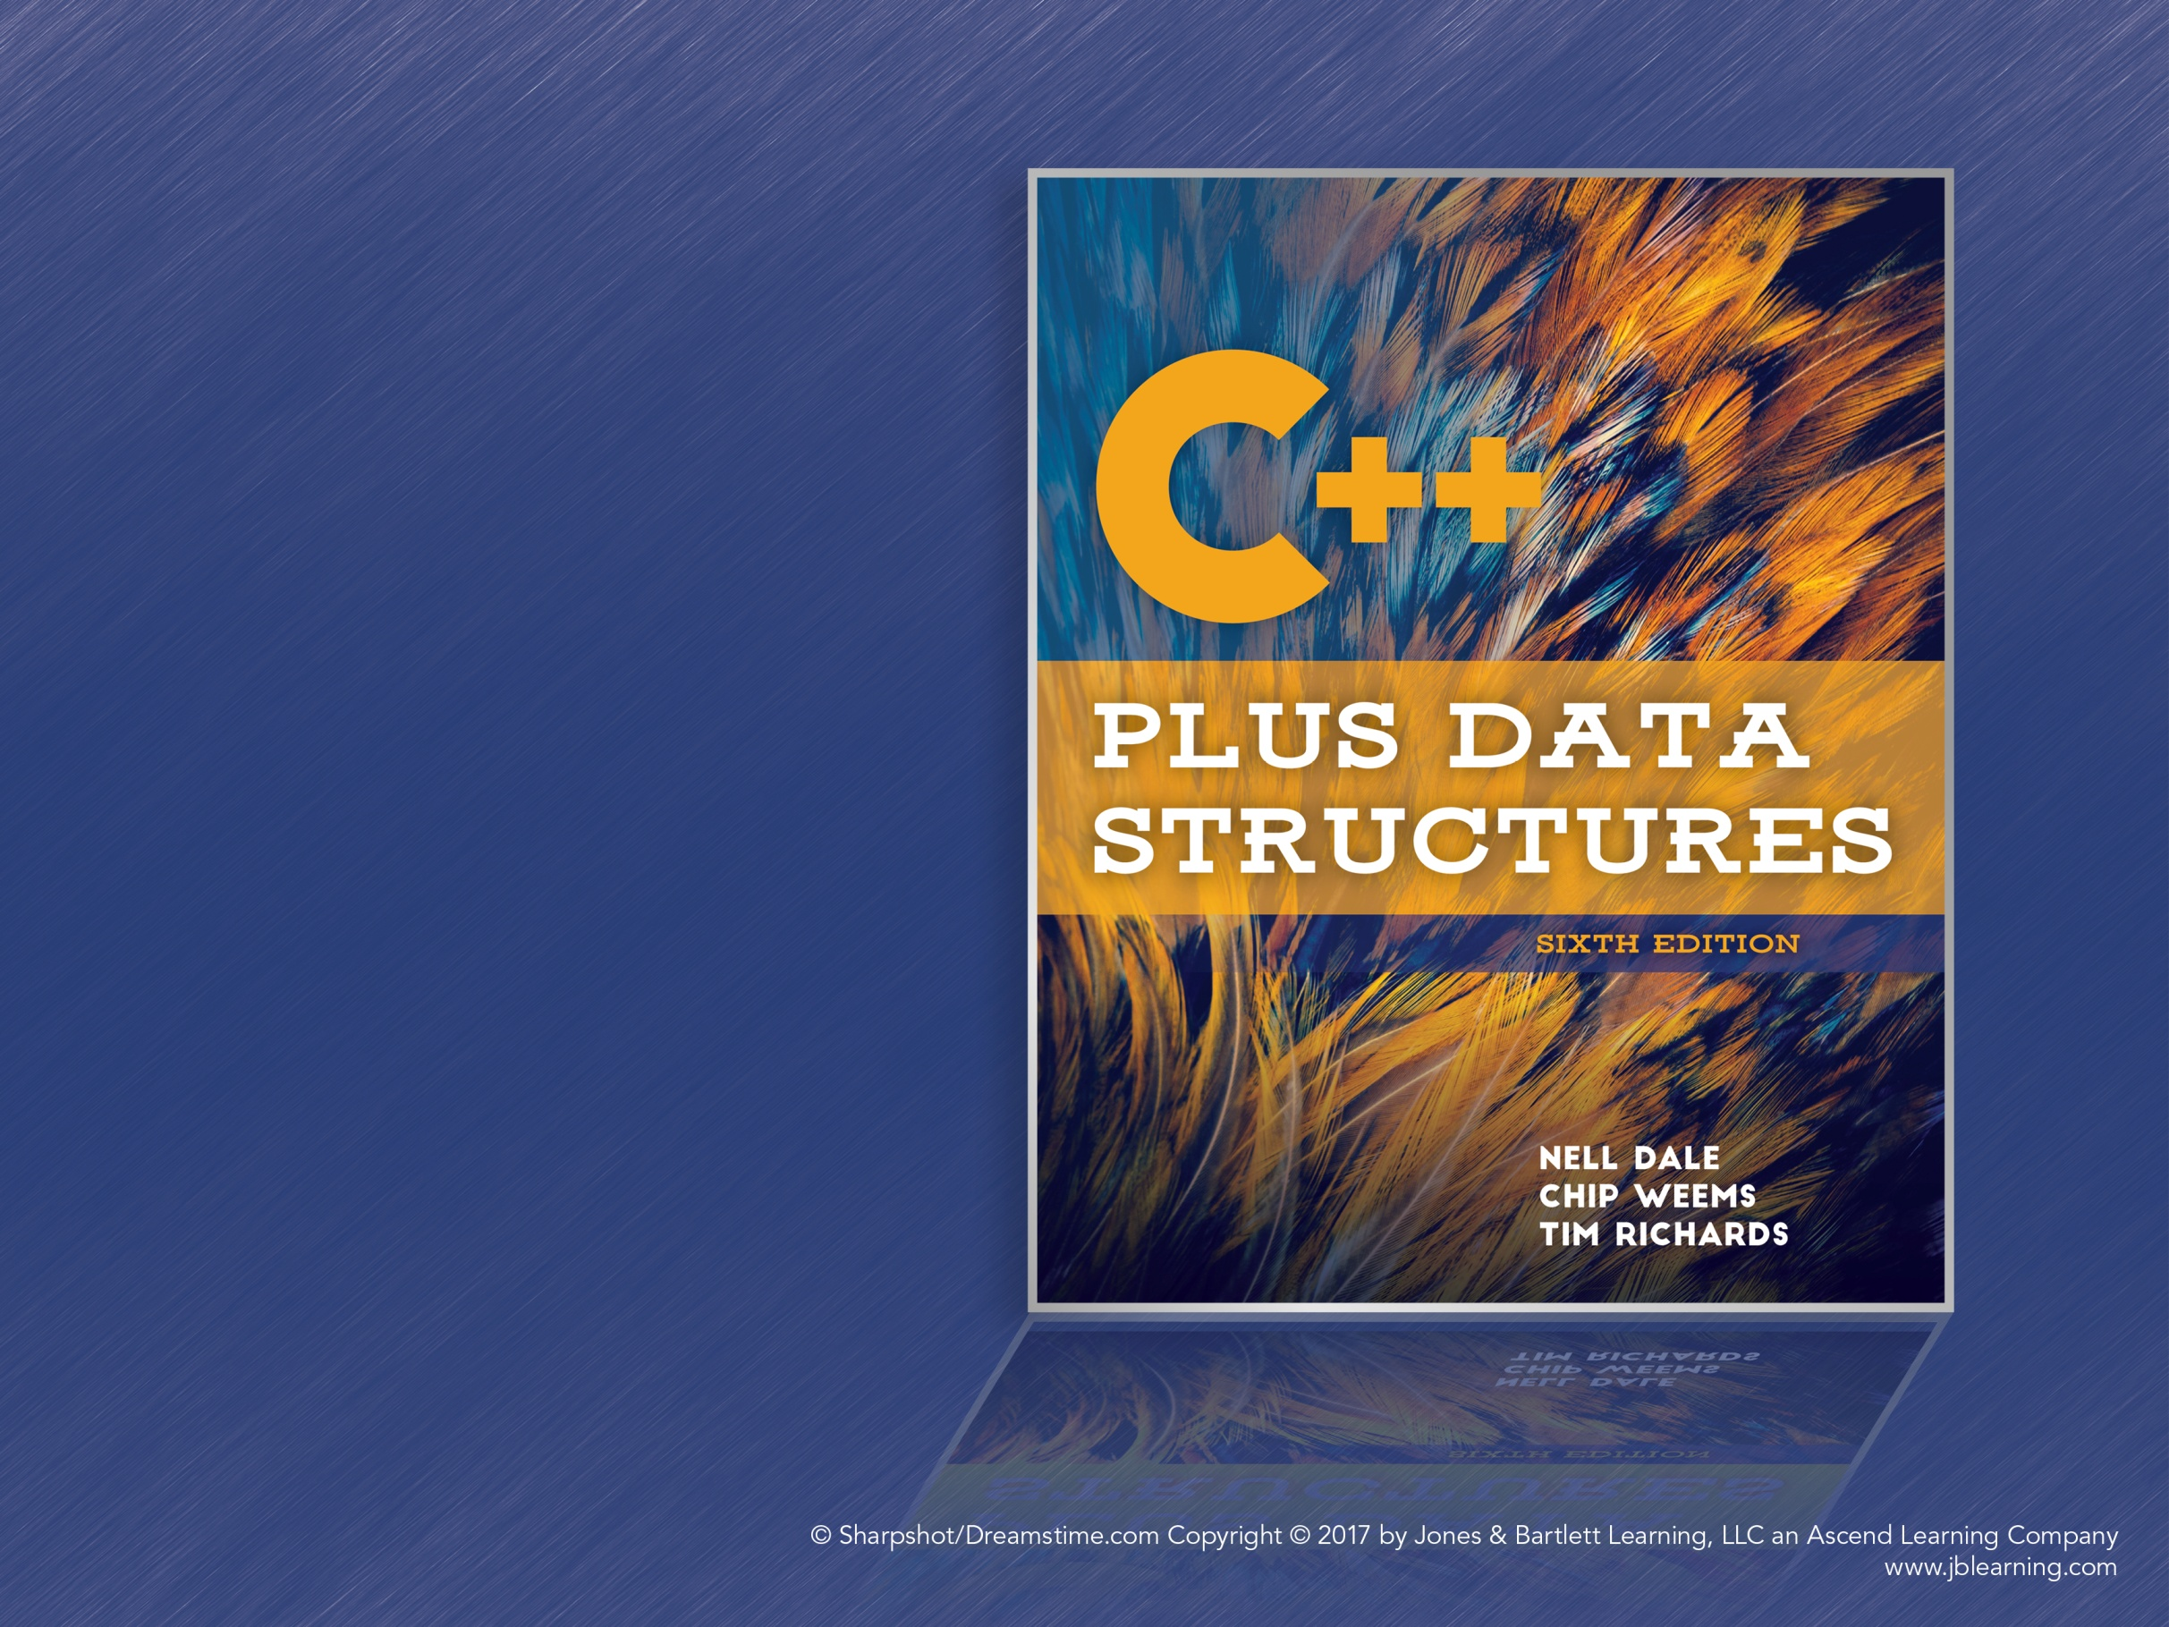
Chapter 1
Software Engineering Principles

Slide 2
The Software Process
How do we write complex programs?
Focus on the software life cycle
Develop techniques of software engineering

Slide 3
Software Engineering
A disciplined approach to the design, production, and maintenance of computer programs
Use tools that help manage the size and complexity of the resulting software
Ensure that projects are developed on time and within cost estimates

Slide 4
The Software Life Cycle
Problem analysis
Requirements elicitation
High- and low-level design
Implementation of the design
Testing and verification
Delivery
Operation
Maintenance

Slide 5
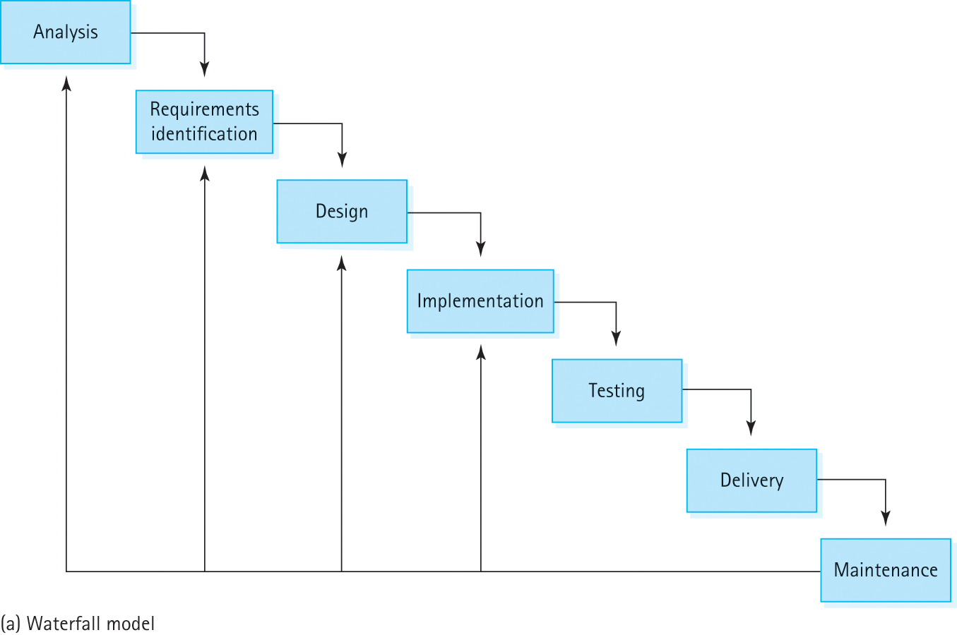
Waterfall Model
Figure 1.1a Life-cycle models: (a) Waterfall model (b) Spiral model

Slide 6
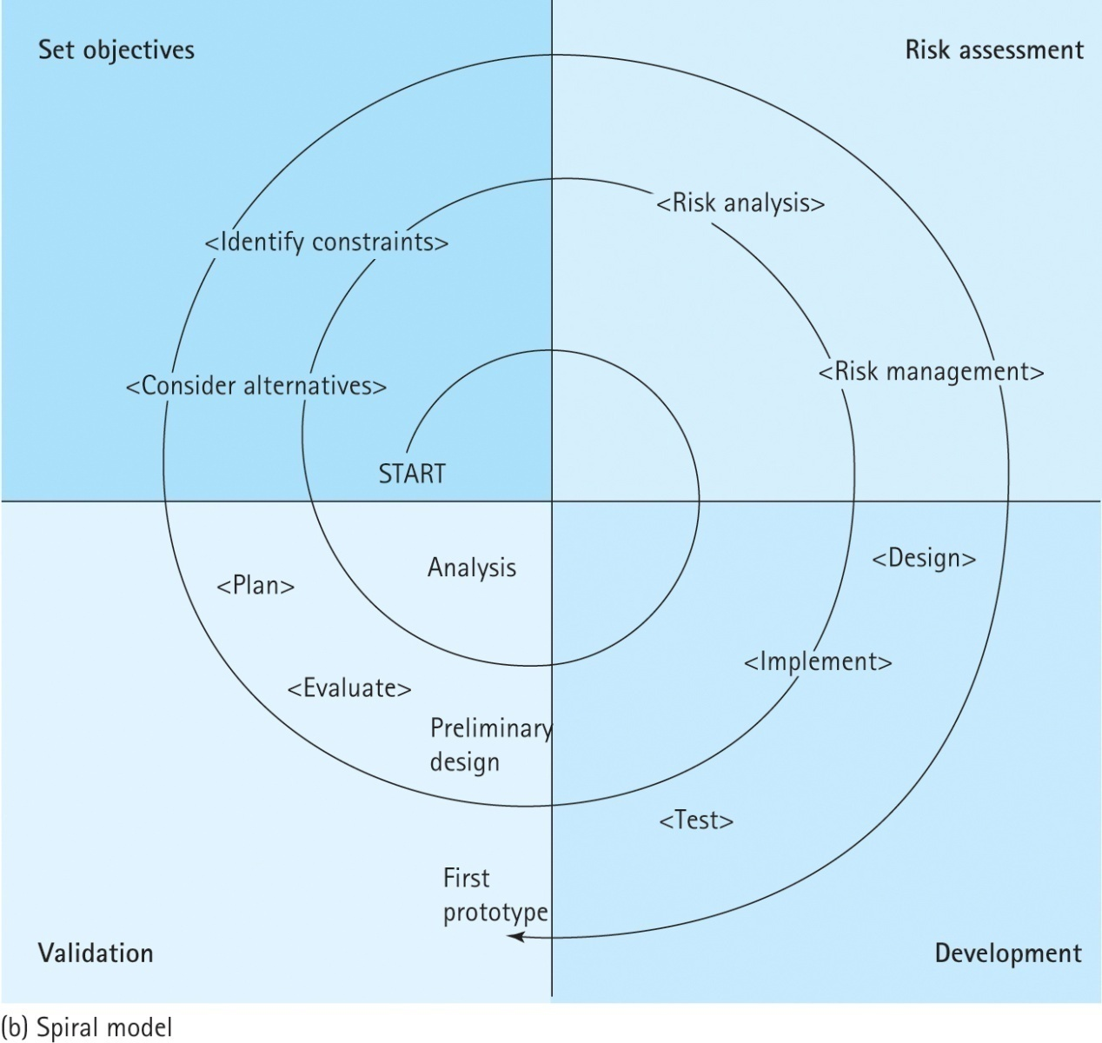
Spiral Model
Figure 1.1b Life-cycle models: (a) Waterfall model (b) Spiral model

Slide 7
Programmer Toolboxes
The various tools and techniques programmers use to create software
Hardware: The computers and other devices
Software: Operating systems, development environments, compilers, debuggers…
Ideaware: The shared body of programming knowledge, such as useful algorithms and programming methodologies

Slide 8
An Algorithm Is…
A logical sequence of discrete steps that describes a complete solution to a problem, computable in a finite amount of time.

Slide 9
Goals of Quality Software
It works
It can be modified without excessive time and effort
It is reusable
It is completed on time and within budget

Slide 10
Quality Software Works
Requirements: Describe what service the software should provide
Software Specification: A written document that tells what a program does but not how
Quality software must be complete and correct, and do everything as explained in the specification

Slide 11
Quality Software Can Be Modified
Changes may occur during the design, coding, and testing phases
Bug fixes and other small changes are made during the maintenance phase
Easily modified programs are readable, well documented, and easily understood by humans

Slide 12
Quality Software Is Reusable
Spend extra effort to make components more general now in order to save time later
Using code that is already designed, implemented, and tested allows programmers to focus on the rest of the program
This does require extra effort during specification and design phases

Slide 13
Quality software is completed on time and within budget
Programmers must be able to work efficiently
Missing a deadline can have significant impact on other projects, people, and companies
“Time is money”

Slide 14
Software Specifications
The specification describes what services a program should provide, based on the users’ requirements
Scenario: Sequence of events describing one complete execution of the program
Useful questions:
What is the expected input and output?
How will errors be handled?
How will the program be used?

Slide 15
Program Design
A program’s specification describes what a program does, not how it does it
Design Phase: Evaluating how a program will accomplish its specified tasks
Many useful ideaware tools can help

Slide 16
Abstraction
A model of a complex system that includes only the essential details
Programs are abstractions
Simplify work by hiding complex details

Slide 17
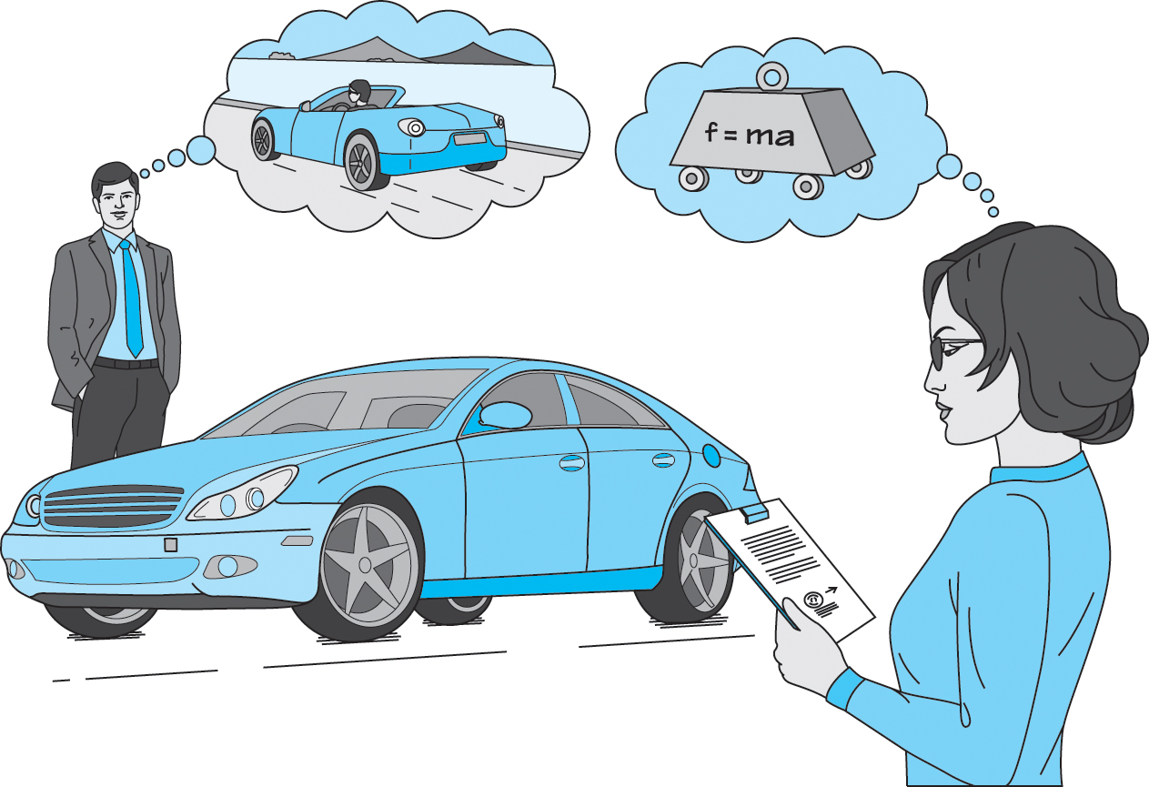
Abstraction (cont.)
Figure 1.2 An abstraction includes the essential details relative to the perspective
of the viewer

Slide 18
Information Hiding
The practice of hiding the details of a module with the goal of controlling access to the details of a module
Module: A cohesive system subunit that performs some share of the work
Information hiding allows programmers to focus on one module at a time
Each module should serve a single purpose

Slide 19
Stepwise Refinement
Approaching a problem in stages, step by step
Top-down: Break problem into pieces, deferring details as long as possible
Bottom-up: Focus on details first and build up to the high-level components
Functional Decomposition: Approach a program as a set of cooperating functions
Round-trip Gestalt: Top-down with emphasis on objects and data

Slide 20
Visual Tools
Abstraction, information hiding, and stepwise refinement help manage complexity
Visual Tools: Help us visualize the design
UML Diagrams: Define components and the relationships between them
CRC Cards: Describe classes, their responsibilities, and their collaborators

Slide 21
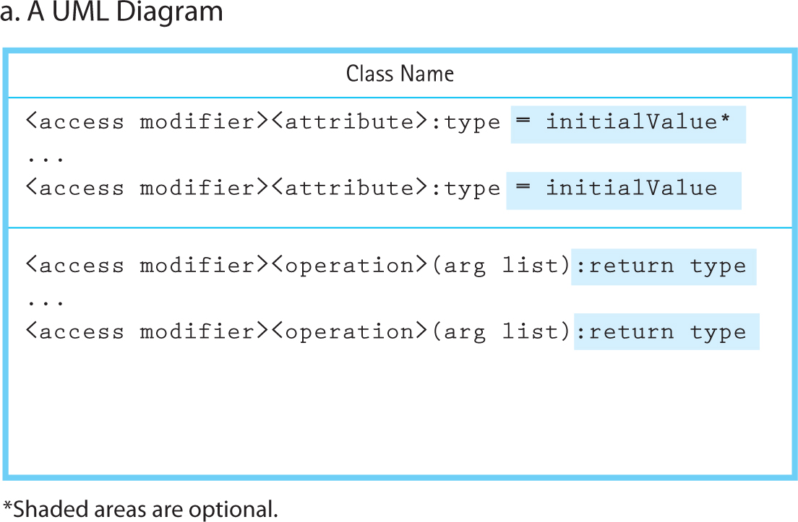
UML Diagrams
Figure 1.3a UML Class Diagram and CRC Card: (a) A UML Diagram (b) A CRC Card

Slide 22
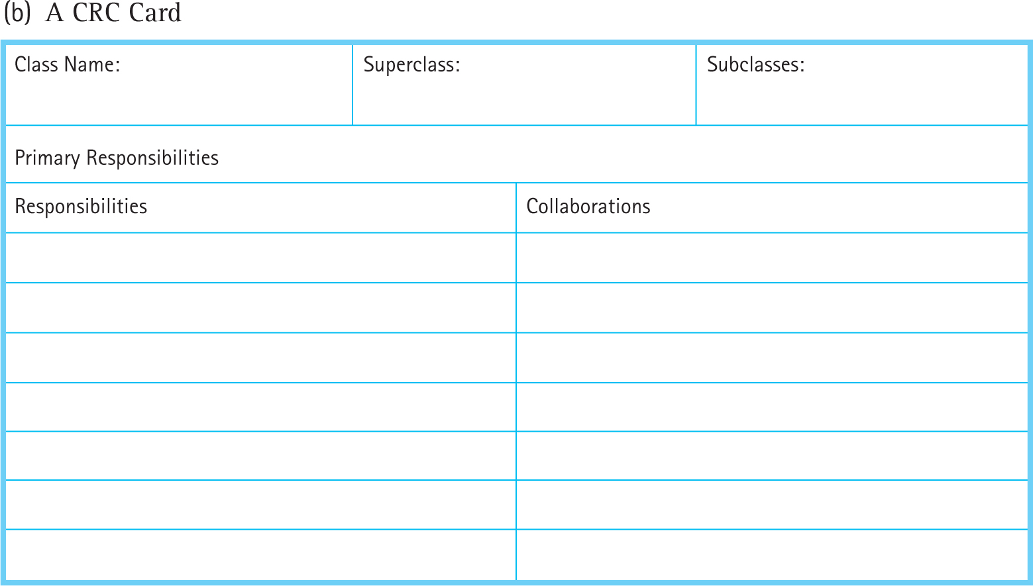
CRC Cards
Figure 1.3b UML Class Diagram and CRC Card: (a) A UML Diagram (b) A CRC Card

Slide 23
Design Approaches
How do we define the modules of a project?
Or, how do we break up a project into modules to work on?

Slide 24
Top-Down Design
Starts with a “big-picture” view of the program
Then, break the picture down into tasks
Continue breaking down the tasks until they can be easily described in code
Functional decomposition breaks the program into functions that form a complete solution to the problem when used together

Slide 25
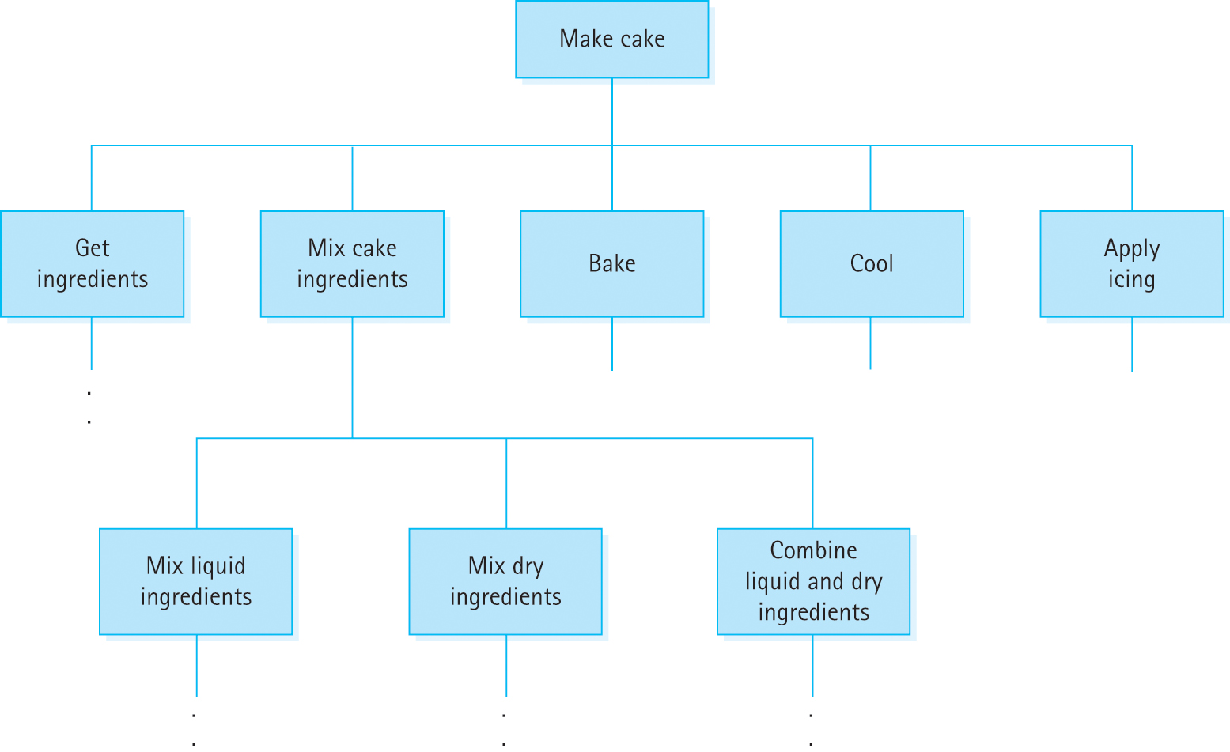
Top-Down Design: Cake
Figure 1.4 A portion of a functional design for baking a cake

Slide 26
Objected-Oriented Design
Divide-and-conquer, but break down the program into things instead of tasks
The design consists of objects, which are defined by classes
Objects combine data and operations

Slide 27
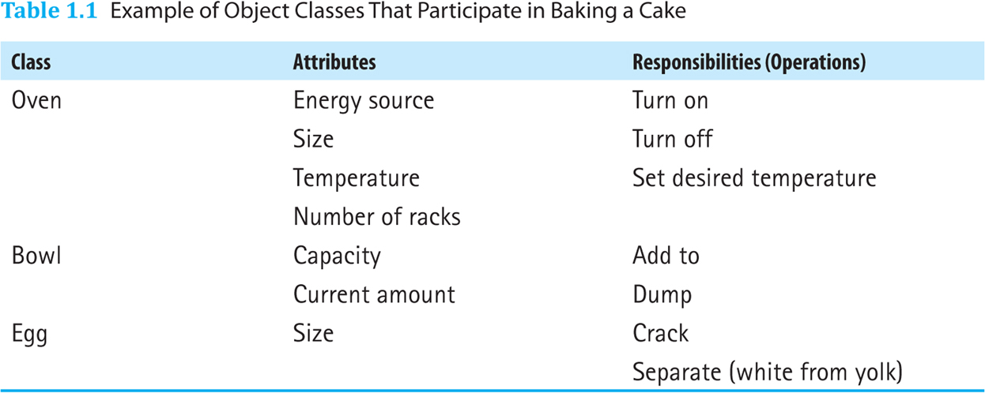
Classes for Baking a Cake
Table 1.1 Example of Object Classes That Participate in Baking a Cake

Slide 28
Procedural vs. Object Oriented
“Read the specification of the software you want to build. Underline the verbs if you are after procedural code, the nouns if you aim for an object-oriented program.”
Grady Booch, “What Is and Isn’t Object Oriented Design,” 1989.

Slide 29
Verification of Software Correctness
Testing: Executing a program with input designed to find errors
Debugging: Investigating and removing known errors from a program
Acceptance Test: Testing in a real environment with real data
Regression Test: Testing that a program is still correct after being modified

Slide 30
Verification and Validation
Is testing enough?
Program Verification: Checking that a program fulfills its specification
“Are we doing the job right?”
Program Validation: Checking that the program fulfills its intended purpose
“Are we doing the right job?”

Slide 31
The Origin of Bugs
Where do bugs occur in a program?
Is there a way to avoid bugs entirely?
What “detective work” is needed to find bugs?

Slide 32
Specification and Design Errors
There may be errors in the specification itself
This is a result of poor communication or a misunderstanding of users’ needs
Bugs are much cheaper to fix while in the specification stage
Once the program has been written and deployed, fixing any errors is very expensive

Slide 33
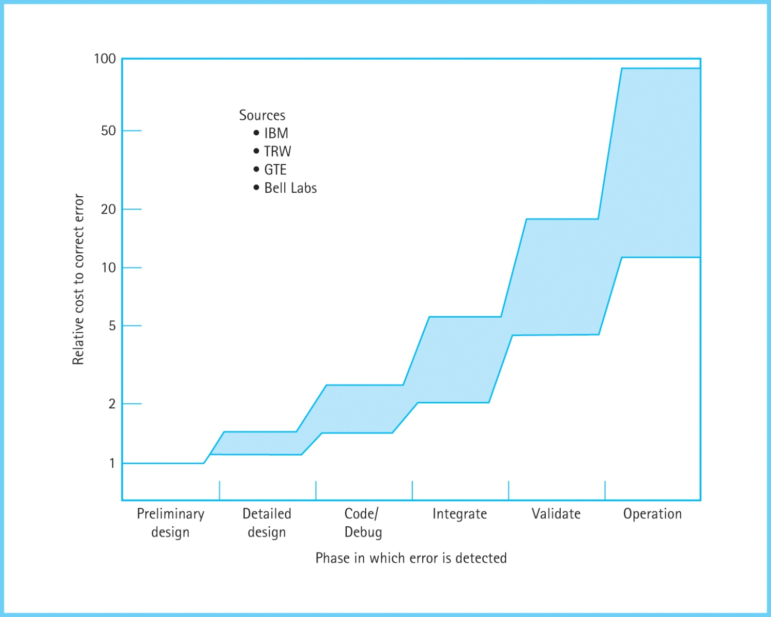
Cost of Specification Errors
Figure 1.5 This graph demonstrates the importance of early detection of software errors

Slide 34
Compile-Time Errors
It’s not impossible to write clean, syntactically correct code on the first try
These errors are generally easier to handle than other types of errors
Knowing your tools (programming language, editor, etc.) will help avoid these errors

Slide 35
Run-Time Errors
An error that occurs during execution, often causing the program to crash
Robustness: The ability of a program to recover from an error
Run-time errors can often be found with sufficient testing
Errors should be handled gracefully instead of allowing the program to crash

Slide 36
Designing for Correctness
We would like to prove a program is correct
Make assertions (logical propositions) about what a program should do
Then, prove the design fulfills the assertions

Slide 37
Conditions on Functions
Assertions can be applied at the module level
Precondition: A condition that must be true before an operation is executed
Postcondition: A condition that will be true after an operation completes
The postcondition will be true if the precondition is true

Slide 38
Design Review Activities
Deskchecking: Tracing an execution of a design or program on paper
Walk-through: A team performs a manual simulation of the program or design
Inspection: One member of a team reads the program or design line by line while others point out the errors

Slide 39
Exceptions
Exceptions allow programs to interrupt normal control flow to handle exceptional situations
Handling them should be part of the design
Different languages have different facilities for handling exceptions

Slide 40
Program Testing
Testing is used to find remaining errors
Test Case: A single test used to check a particular program feature. For each case:
Determine inputs
Determine the expected behavior of the program
Run the program and observe its behavior
Compare the expected behavior and the actual behavior

Slide 41
Unit Testing and Coverage
Unit Testing: Testing a program module or function individually
It’s hard to say how many unit tests are needed
Two coverage approaches:
Cases based on possible inputs
Cases based on aspects of the code
Metric-based Testing: Goals are based on measurable factors like coverage

Slide 42
Data Coverage
Use a wide range of inputs to test the behavior of a module
Exhaustive coverage means to test all possible inputs, which is usually impossible for most function domains
The general approach is to cover typical cases and the edge cases
Black-box Testing: Test based on the inputs, ignoring the actual code

Slide 43
Code Coverage
Use tests that evaluate as many parts of the module as possible
Branch: A code segment that is not always executed
Path: A sequence of branches that is traveled during execution
White-box Testing: Testing based on covering all statements, branches, or paths in a module

Slide 44
Test Plans
A document showing test cases for a module, their purposes, inputs, expected outputs, and the criteria for success
For program testing to be effective, it must be planned
Start planning for testing before writing a single line of code
Test Driver: Program that runs the test plan

Slide 45
Planning for Debugging
We can plan for debugging from the start
Provide a global output file to write debugging information to
Use a global Boolean flag to control when debugging information will be printed
More structured than adding print statements
Too many debugging statements can obscure code!

Slide 46
Integration Testing
Unit testing does not guarantee modules will be error-free when used together
Integration Testing: Testing that ensures modules will work when used together
“Divide-and-conquer” approach, similar to design phase
Two approaches: top-down and bottom-up

Slide 47
Top-Down Integration Testing
Ensure the overall logical design works and interfaces between modules are correct
Assumes low-level details are correct
Low-level subprograms are replaced with stubs or placeholder modules
Stubs may print debugging information and return values, but do not perform actual work

Slide 48
Bottom-Up Approach
Uses a test driver to use individual modules together
Starts with the lowest-level modules in the design and works up to the top-level program
Useful when different authors wrote and tested separate modules

Slide 49
Testing C++ Data Structures
Goal: Test the various operations of a data structure in an efficient manner
Solution: Describe the test cases in a file, use a test driver to read and execute the test cases, writing the output to another file
This allows for generalized testing
Requires a test driver for each structure

Slide 50
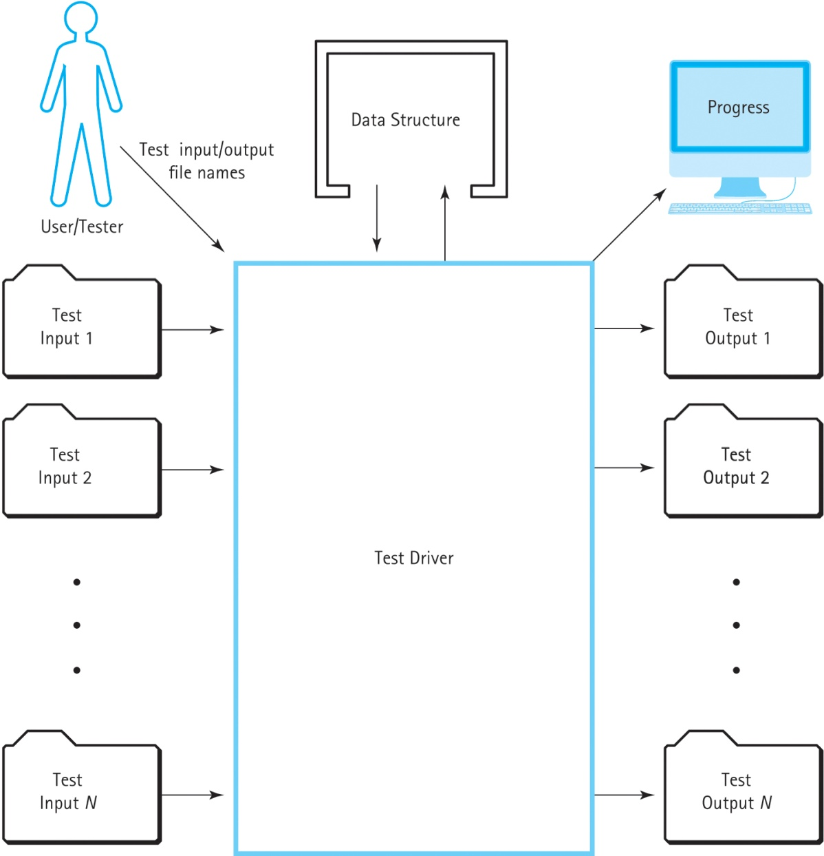
Testing C++ Data Structures (cont.)
Figure 1.9 Model of test architecture

Slide 51
Testing C++ Data Structures (cont.)
The input file lists commands for the test driver to execute
Commands are specific operations for the structure, along with commands like “Quit”
Input file also specifies the input for each command to use

Slide 52
Practical Considerations
How much verification is necessary?
Must balance between time constraints, the effort required, and the impact of errors
Verification should be started as early as possible
Critical software must have lower error rates

Slide 53
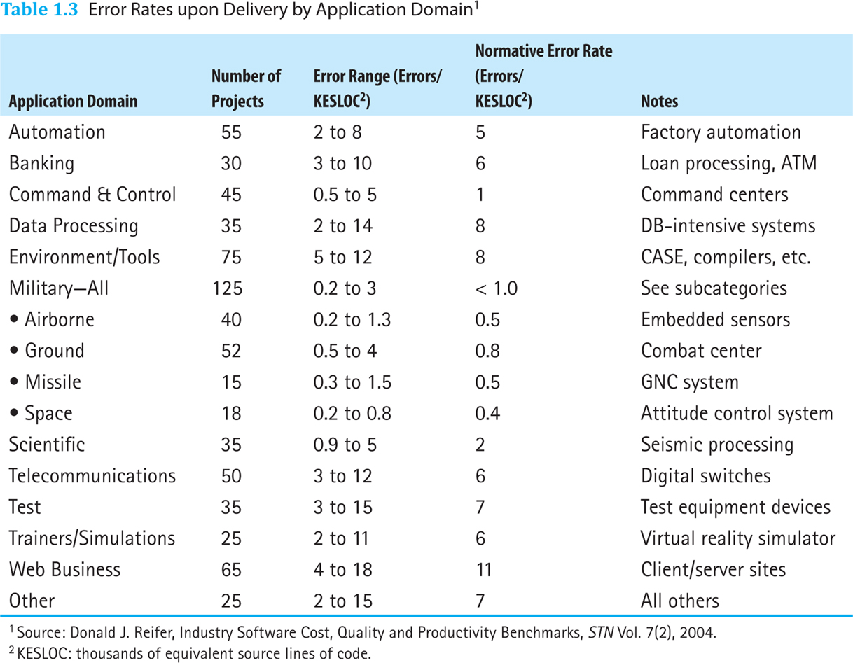
Errors Rates in Software
Table 1.3 Error Rates upon Delivery by Application Domain¹
Data from: Donald J. Reifer, Industry Software Cost, Quality and Productivity Benchmarks, STN Vol 7(2), 2004. KESLOC: Thousands of equivalent source lines of code.

Slide 54
Streaming Input and Output
C++ uses streams to handle input and output
The <iostream> header file defines:
“cin” (standard input stream) (the keyboard)
“cout” (standard output stream) (the screen)
“cerr” (standard error output stream) (the screen)
Streams use the “<<” and “>>” operators

Slide 55
Insertion Operator (<<)
The insertion operator (<<) takes 2 operands
The left operand is the stream to operate on, such as cout
The right operand describes what will be inserted into the stream

Slide 56
Extraction Operator
The extraction operator (>>) takes 2 operands
The left operand is a stream to operate on, such as cin
The right operand is a variable that will be given a value from the stream
The operator attempts to extract the next item from the input stream and store its value in the variable

Slide 57
File I/O
File I/O is defined in the <fstream> header
It uses streams just like <iostream>
Defines input (ifstream) and output (ofstream) file objects
Make sure to close the file when finished!

Slide 58
Stream Failure
When a stream enters the fail state, further I/O operations using that stream are ignored
The program does not crash and there is no error message
Possible reasons for entering the fail state are:
Invalid input data (often using the wrong type)
Opening an input file that doesn’t exist
Opening an output file that is write-protected

